Slide 1
Species richness – calculated from observed data – Katja request

Slide 2
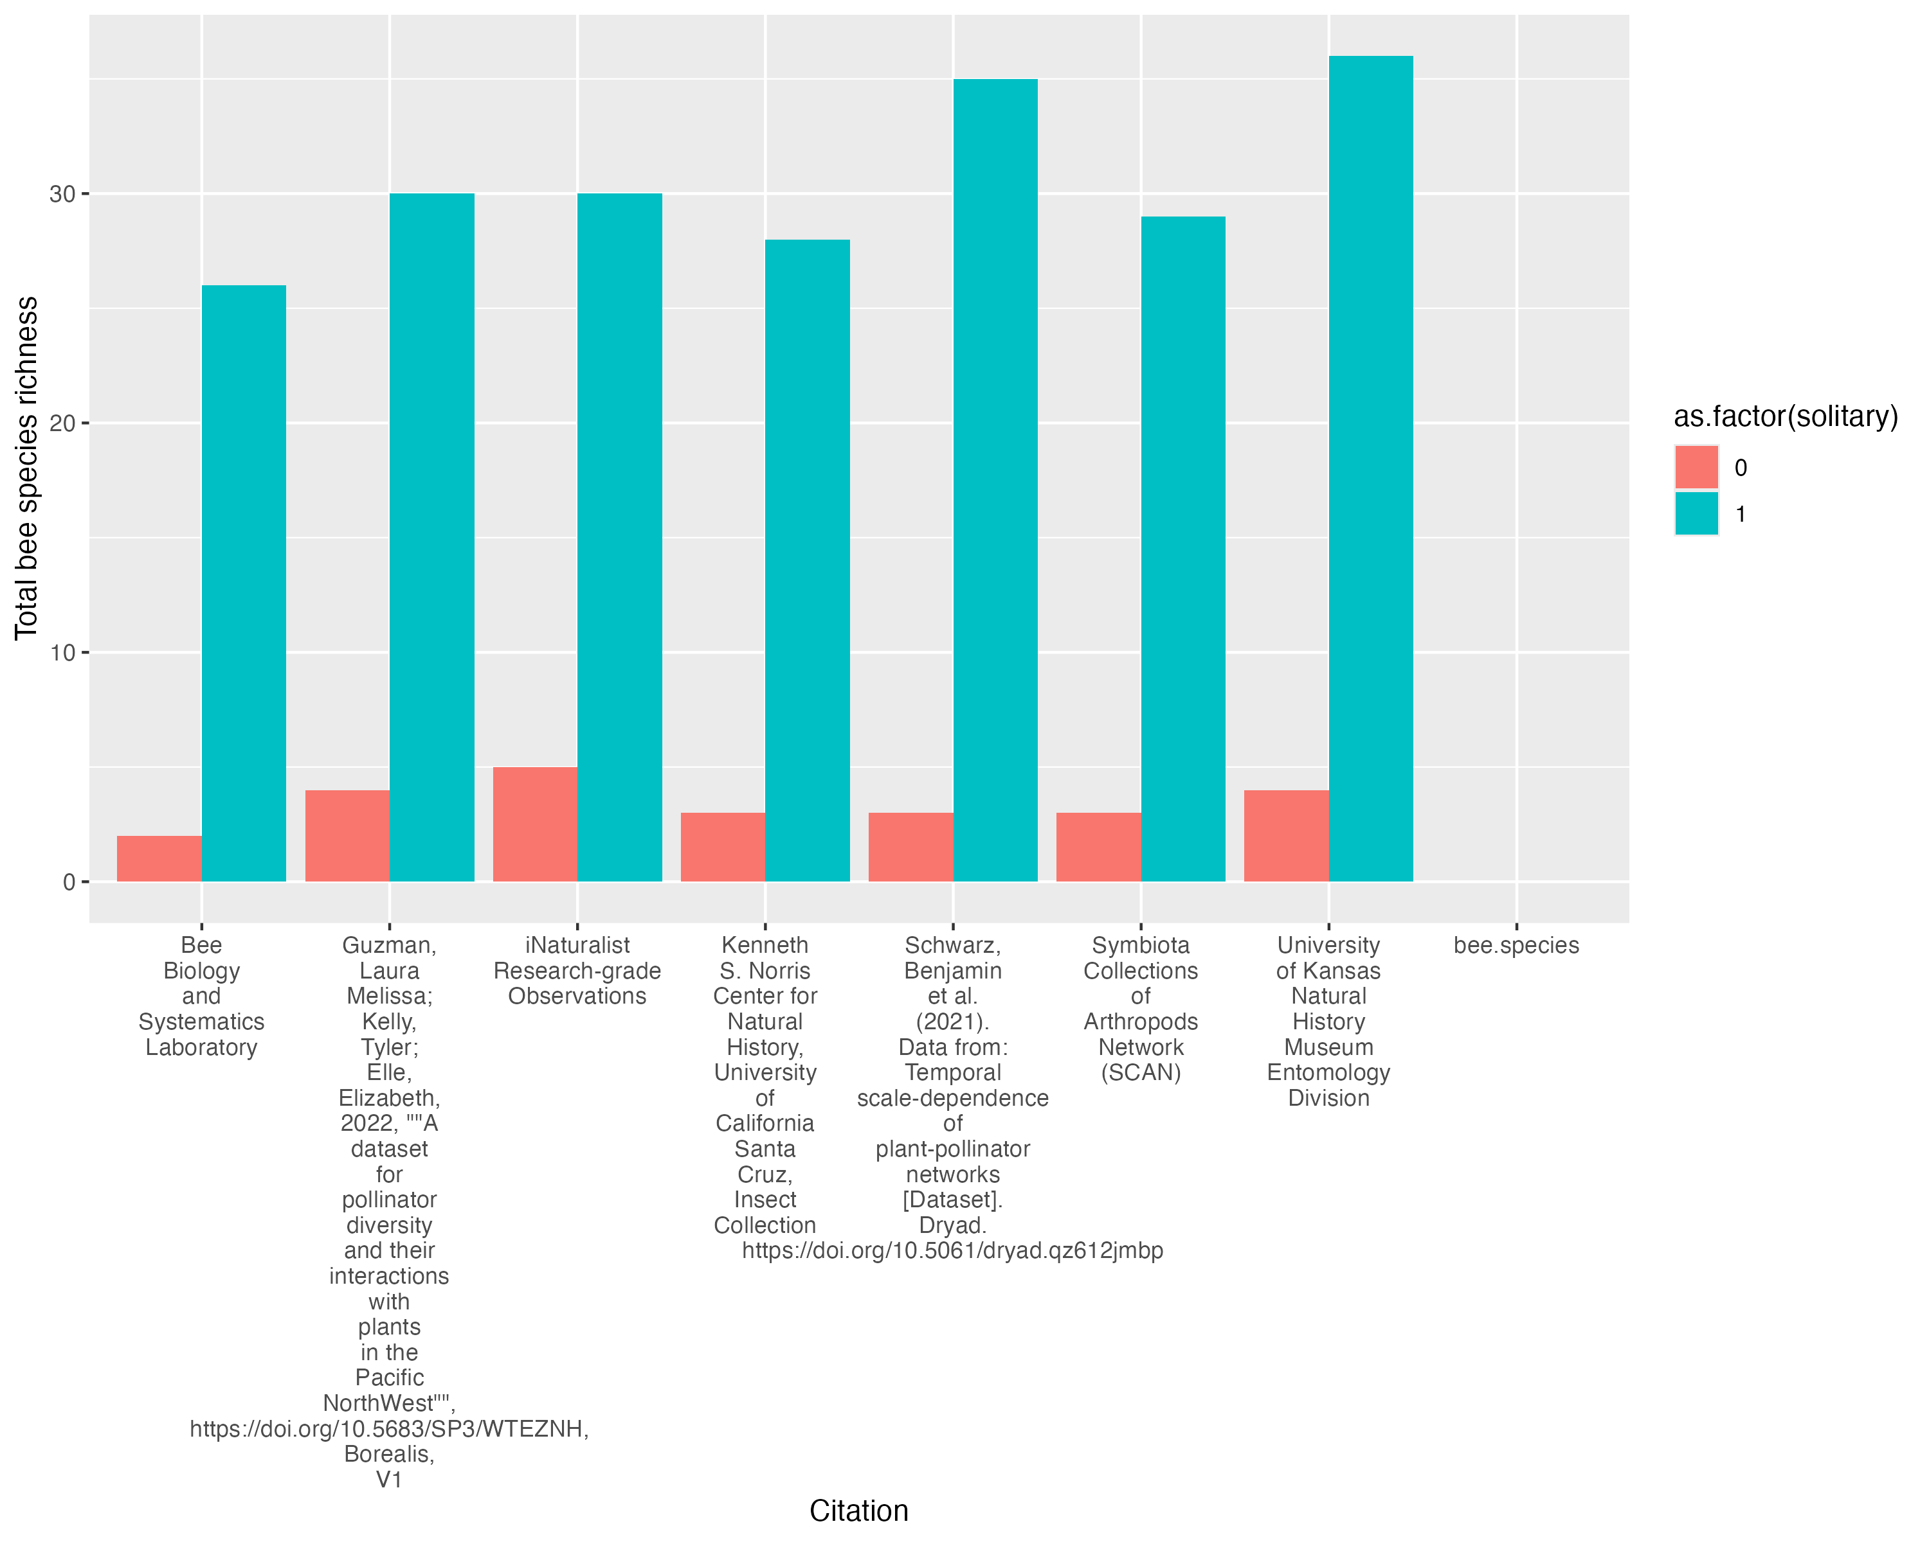
Solitary = 0 == NOT solitary
Solitary = 1 == YES solitary

Slide 3
Model output on 2024 07 17

Slide 4
Ecological process

Slide 5
There is a 95.24% probability this relationship is negative

Slide 6
There is a 21.74% probability that not solitary bees have a higher interaction probability than solitary bees

Slide 7
There is a 12% probability that yellow flowers have a higher interaction probability than other colored flowers
There is a 98% probability that yellow flowers have a higher interaction probability than white flowers
There is a 0% probability that yellow flowers have a higher interaction probability than blue flowers

Slide 8
There is a 97.70% probability that not bowl flowers have a higher interaction probability than bowl flowers

Slide 9
Detection process

Slide 10
There is a 83.91% probability this relationship is positive

Slide 11
There is a 1.0 probability stripped bees had a higher detection probability than not stripped bees.

Slide 12
There is a 100% probability that Observation sources have a higher detection probability than each of the other 3 source types

Slide 13
There is a 100% probability that yellow flowers have a higher detection probability than other colored flowers
There is a 4.49% probability that yellow flowers have a higher detection probability than white flowers
There is a 78.44% probability that yellow flowers have a higher detection probability than blue flowers

Slide 14
There is a 100% probability that not bowl flowers have a lower detection probability than bowl flowers

Slide 15
Total number of plant interactions by bee species (observation in red; model output in black)

